Slide 1

How to Really use Udio Part 2

Slide 2
What is covered
What is Udio?
Getting Started
A Tour of the Environment
The Importance of Good Prompts
Creating Music
Working with Advanced Features
Remixing
Extending

Slide 3
A tour of the environment

Slide 4
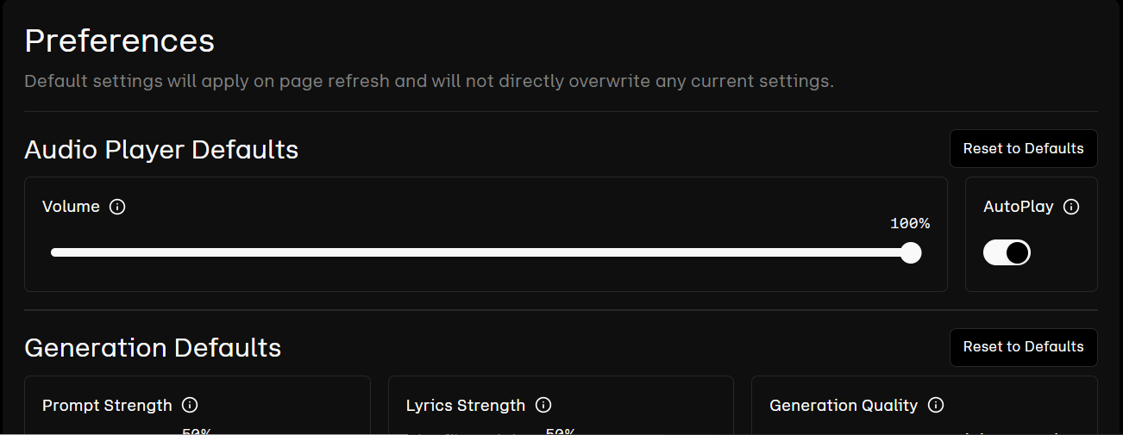
Notes:
https://www.udio.com/preferences

Slide 5
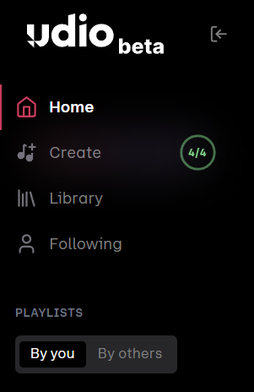

Slide 6
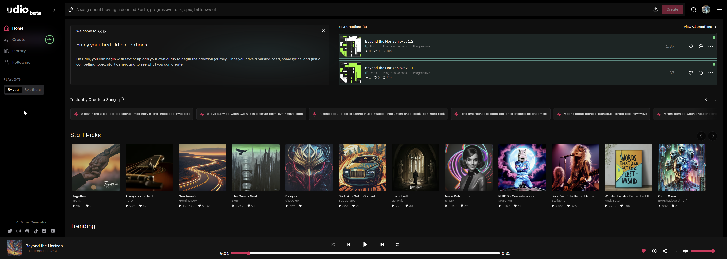
Home

Slide 7
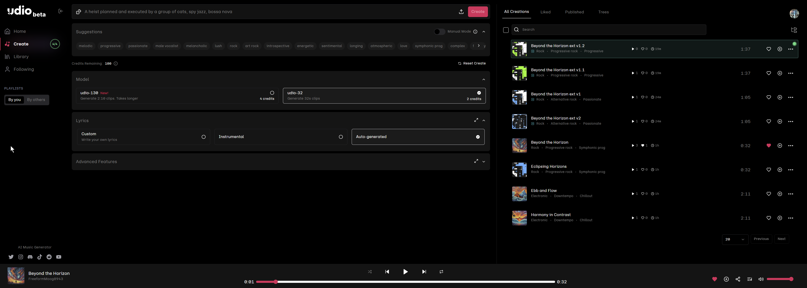
create

Slide 8




Notes:
https://www.youtube.com/channel/UC35ZpwldGw7ZJ5R-2sLijzw

Slide 9


Membership has its privileges
Notes:
https://www.youtube.com/channel/UC35ZpwldGw7ZJ5R-2sLijzw/join

Slide 10

https://www.youtube.com/@AINewsFresh

Slide 11
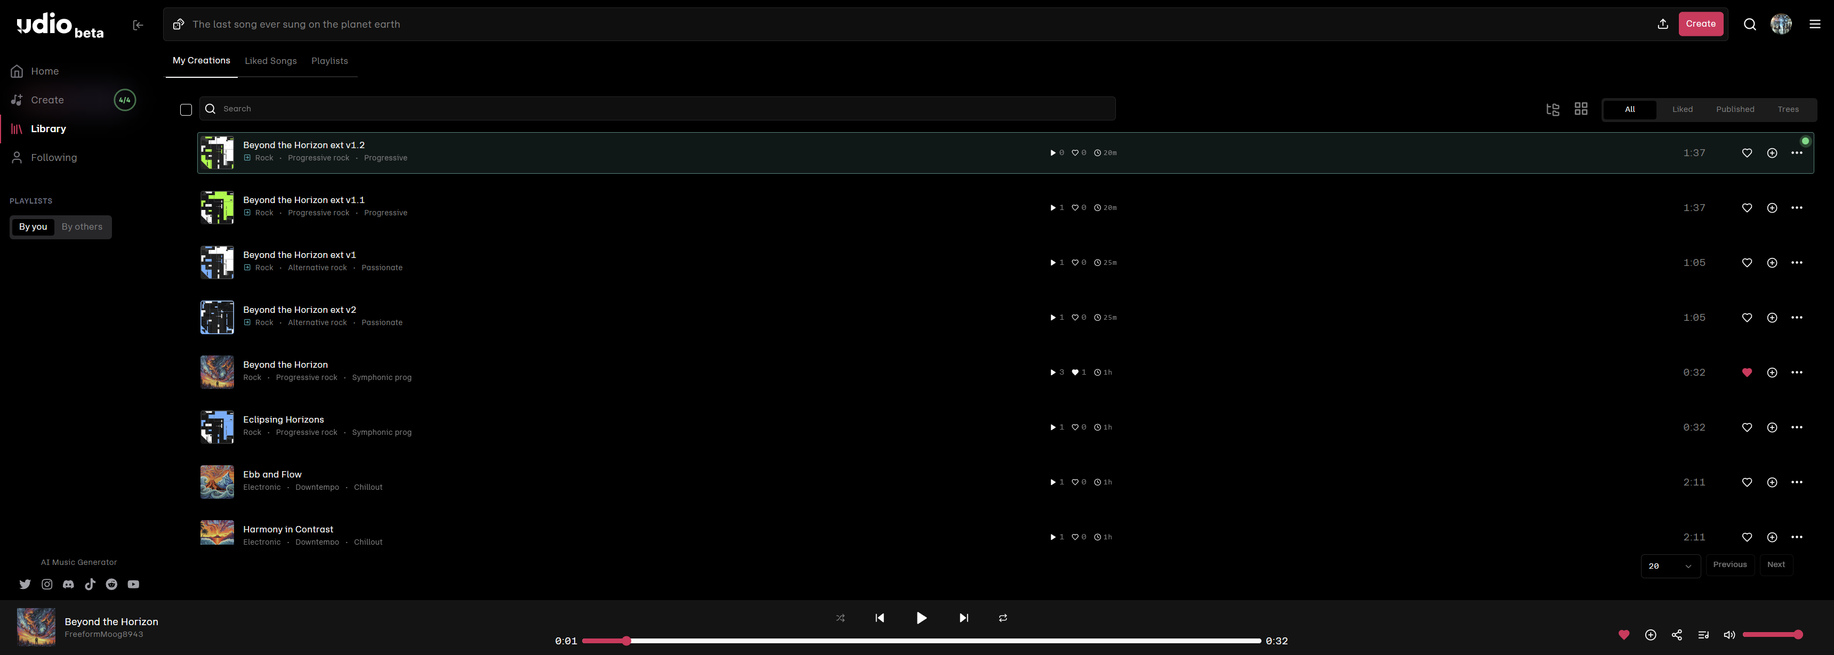
Library

Slide 12
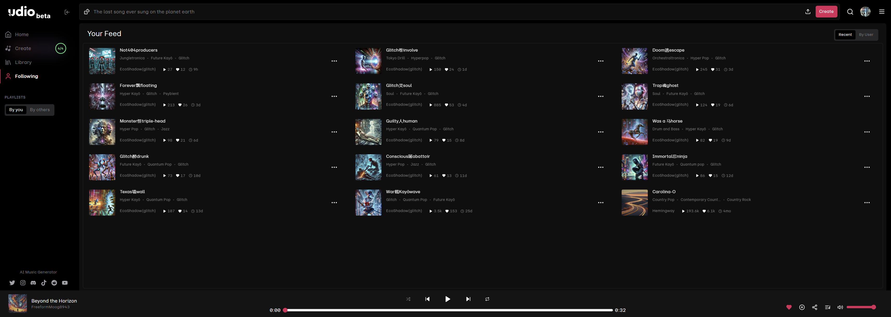
Following

Slide 13
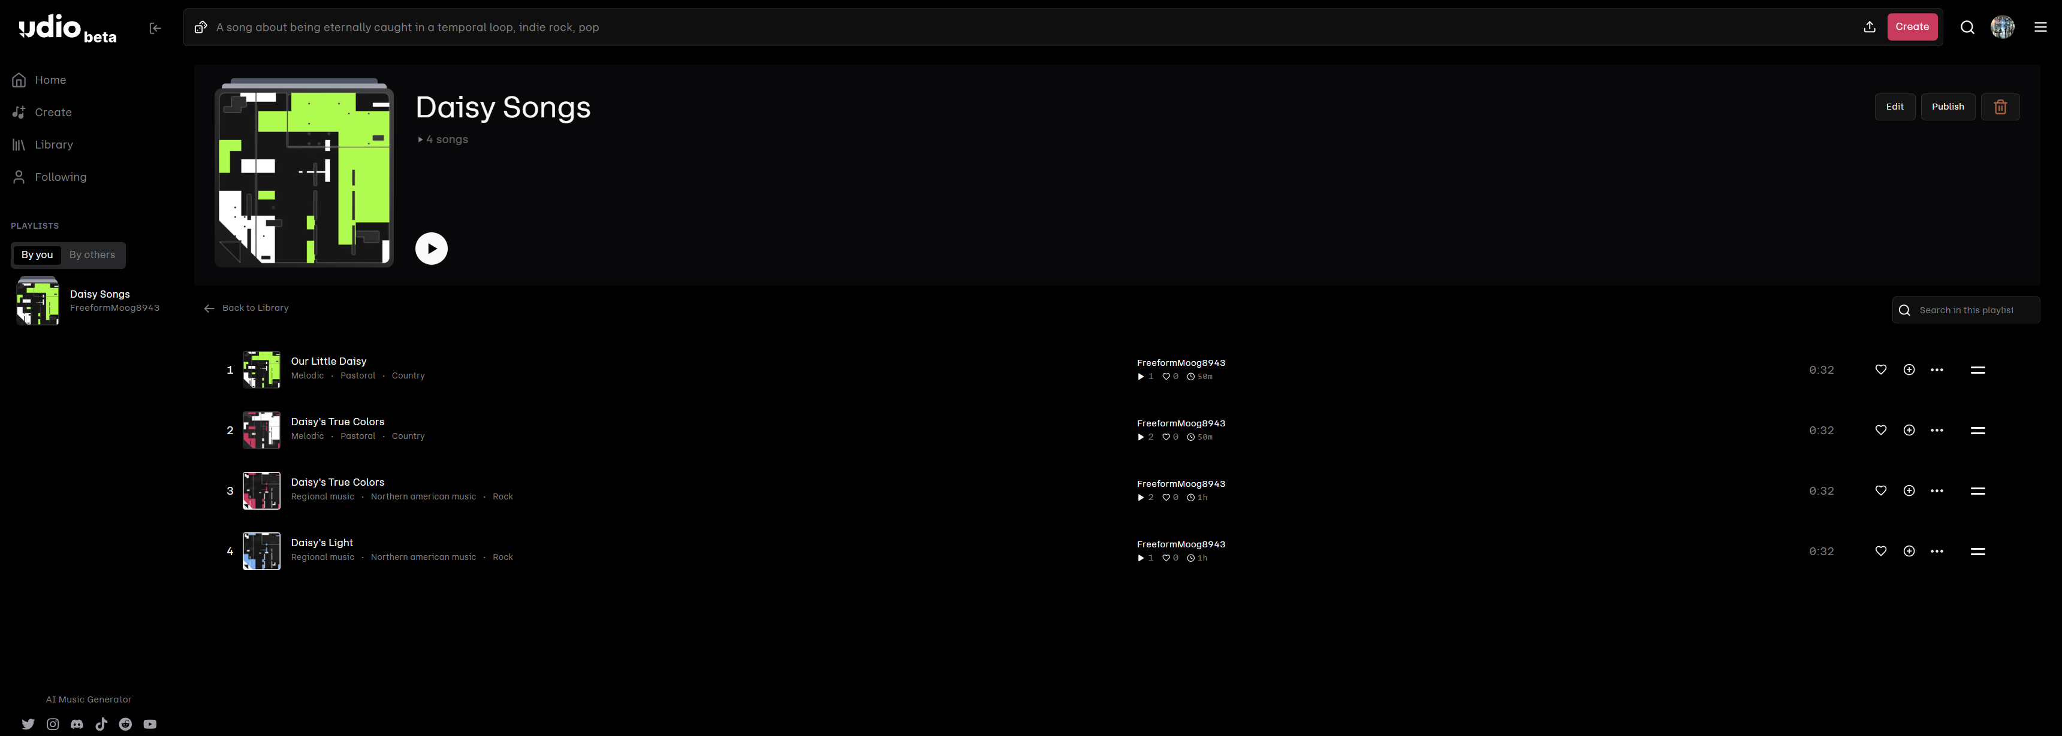
Playlists

